Slide 1
Analysis of Algorithms

Slide 2
Analysis of algorithms
Issues:
  correctness
  time efficiency
  space efficiency
  optimality
Approaches:
  theoretical analysis
  empirical analysis

Slide 3
Theoretical analysis of time efficiency
Time efficiency is analyzed by determining the number of repetitions of the basic operation as a function of input size
Basic operation: the operation that contributes most towards the running time of the algorithm
T(n) ≈ c_{op}C(n)
input size
running time
execution time
for basic operation
Number of times basic operation is executed

Slide 4
Input size and basic operation examples
Problem | Input size measure | Basic operation
Searching for key in a list of n items | Number of list’s items, i.e. n | Key comparison
Multiplication of two matrices | Matrix dimensions or total number of elements | Multiplication of two numbers
Checking primality of a given integer n | n’size = number of digits (in binary representation) | Division
Typical graph problem | #vertices and/or edges | Visiting a vertex or traversing an edge

Slide 5
Empirical analysis of time efficiency
Select a specific (typical) sample of inputs
Use physical unit of time (e.g., milliseconds)
or
Count actual number of basic operation’s executions
Analyze the empirical data

Slide 6
Best-case, average-case, worst-case
For some algorithms efficiency depends on form of input:
Worst case: C_{worst}(n) – maximum over inputs of size n
Best case: C_{best}(n) – minimum over inputs of size n
Average case: C_{avg}(n) – “average” over inputs of size n
  Number of times the basic operation will be executed on typical input
  NOT the average of worst and best case
  Expected number of basic operations considered as a random variable under some assumption about the probability distribution of all possible inputs

Slide 7
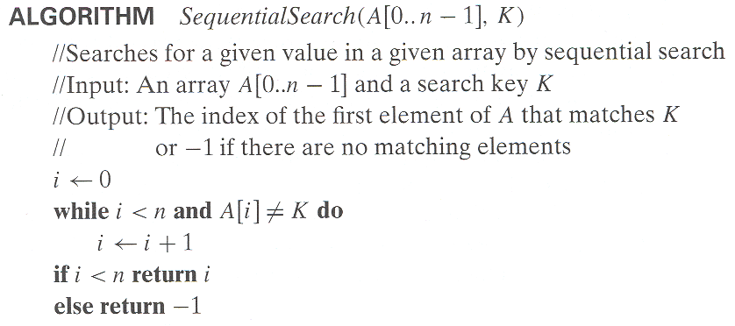
Example: Sequential search
Worst case
Best case
Average case

Slide 8
Average Case of Sequential Search
Average case: Assumption
(a) the probability of a successful search is equal to p, 0 <= p <=1
(b) the probability of the first match occurring in the i^{th} position of the list is the same for every i
1 [success] the probability of the first match occurring in the i^{th} position of the list is p/n. the number of comparison is i.
2 [unsuccess] the number of comparison is n.
Therefore:
C_{avg} (n) = [1.p/n + 2.p/n +…+i.p/n+…+n.p/n] + n.(1-p)
= p/n[1+2+…i+…n] + n(1-p)
= p/n . n(n+1)/2 + n(1-p) = p(n+1)/2 + n(1-p)

Slide 9

Puzzle

Slide 10
Puzzle
Glove Selection: There are 22 gloves in a drawer: 5 pairs of red groves, 4 pairs of yellow, and 2 pairs of green. You select grove in the dark and can check them only after the selection has been made. What is the smallest number of groves you need to select to have at least one matching pair:
  in the best case?
  in the worst case?
Notes:
2 and 12

Slide 11
Types of formulas for basic operation’s count
Exact formula
e.g., C(n) = n(n-1)/2
Formula indicating order of growth with specific multiplicative constant
e.g., C(n) ≈ 0.5 n²
Formula indicating order of growth with unknown multiplicative constant
e.g., C(n) ≈ cn²

Slide 12
Order of growth
Most important: Order of growth within a constant multiple as n→∞
Example:
  How much faster will algorithm run on computer that is twice as fast?
  How much longer does it take to solve problem of double input size?
Notes:
Example: cn²
how much faster on twice as fast computer? (2)
how much longer for 2n? (4)

Slide 13
Double Input Size
Example: Assuming that C(n) = ½ n (n-1)
How much longer will the algorithm run if we double its input size, T(2n)?

Slide 14
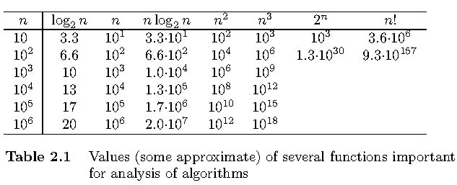
Values of some important functions as n → ∞

Slide 15
Asymptotic order of growth
A way of comparing functions that ignores constant factors and small input sizes
O(g(n)): class of functions f(n) that grow no faster than g(n)
Θ(g(n)): class of functions f(n) that grow at same rate as g(n)
Ω(g(n)): class of functions f(n) that grow at least as fast as g(n)

Slide 16
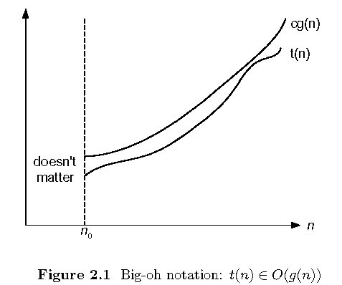
Big-oh

Slide 17
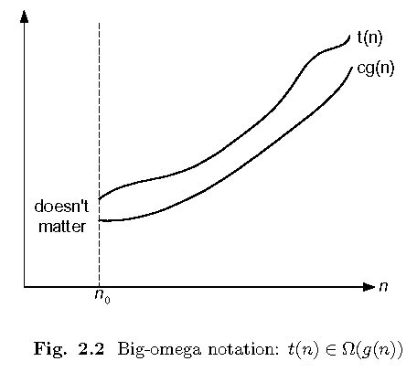
Big-omega

Slide 18
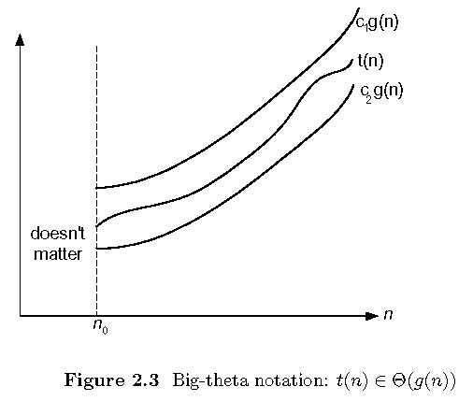
Big-theta

Slide 19
Properties of Logarithms
log_{a} 1 = 0 lg x is log₂ x
log_{a} x = 1/(log_{x} a)
log_{a} a = 1
log_{a} x^{y} = y log_{a} x
log_{a} xy = log_{a} x + log_{a} y
log_{a} (x/y) = log_{a} x - log_{a} y
log_{a} x = (log_{b} x)/(log_{b} a) = (log_{b} x)(log_{a} b)
a = x
log_{b} x
log_{b} a

Slide 20
Establishing order of growth using the definition
Definition: f(n) is in O(g(n)) if order of growth of f(n) ≤ order of growth of g(n) (within constant multiple),
i.e., there exist positive constant c and non-negative integer n₀ such that
f(n) ≤ c g(n) for every n ≥ n₀
Examples:
10n is O(n²)
5n+20 is O(n)
Notes:
Examples:
10n is O(n²)
since 10n ≤ 10n² for n ≥ 1 or 10n ≤ n² for n ≥ 10
c n₀
5n+20 is O(10n)
since 5n+20 ≤ 10 n for n ≥ 4
c n₀

Slide 21
Establishing order of growth using the definition
Definition: f(n) is in Ω(g(n)) if order of growth of f(n) ≥ order of growth of g(n) (within constant multiple),
i.e., there exist positive constant c and non-negative integer n₀ such that
f(n) ≥ c g(n) for every n ≥ n₀
Examples:
10n is Ω(n)
n²+5n+20 is Ω(n²)
n²+5n+20 is Ω(n)
Notes:
Examples:
10n is O(n²)
since 10n ≤ 10n² for n ≥ 1 or 10n ≤ n² for n ≥ 10
c n₀
5n+20 is O(10n)
since 5n+20 ≤ 10 n for n ≥ 4
c n₀

Slide 22
Establishing order of growth using the definition
Definition: f(n) is in Θ(g(n)) if order of growth of f(n) = order of growth of g(n) (within constant multiple),
i.e., there exist positive constants c₁ and c₂ and non-negative integer n₀ such that
c₁ g(n) ≤ f(n) ≤ c₂ g(n) for every n ≥ n₀
Examples:
10n is Θ(n)
5n+20 is Θ(n)
n²+5n+20 is Θ(n²)
Notes:
Examples:
10n is O(n²)
since 10n ≤ 10n² for n ≥ 1 or 10n ≤ n² for n ≥ 10
c n₀
5n+20 is O(10n)
since 5n+20 ≤ 10 n for n ≥ 4
c n₀

Slide 24
Some properties of asymptotic order of growth
f(n) ∈ O(f(n))
f(n) ∈ O(g(n)) iff g(n) ∈Ω(f(n))
If f (n) ∈ O(g (n)) and g(n) ∈ O(h(n)) , then f(n) ∈ O(h(n))
Note similarity with a ≤ b
If f₁(n) ∈ O(g₁(n)) and f₂(n) ∈ O(g₂(n)) , then
f₁(n) + f₂(n) ∈ O(max{g₁(n), g₂(n)})

Slide 25
O ( ) ?
for ( i = 1 to n)
….
….
for ( j=1 to n)
for ( k=1 to n)
….
….
for ( m = 1 to n)
….
….

Slide 26
Establishing order of growth using limits
0 order of growth of T(n) < order of growth of g(n)
lim T(n)/g(n) =
c > 0 order of growth of T(n) = order of growth of g(n)
n→∞
∞ order of growth of T(n) > order of growth of g(n)
Examples:
10n vs. n²
n(n+1)/2 vs. n²

Slide 27
L’Hôpital’s rule and Stirling’s formula
L’Hôpital’s rule: If lim_{n→∞} f(n) = lim_{n→∞} g(n) = ∞ and
the derivatives f´, g´ exist, then
Stirling’s formula: n! ≈ (2πn)^{1/2} (n/e)^{n}
f(n)
g(n)
f ´(n)
g ´(n)
lim
n→∞
=
lim
n→∞
Example: log n vs. n
Example: 2^{n} vs. n!

Slide 28
Orders of growth of some important functions
All logarithmic functions log_{a} n belong to the same class
Θ(log n) no matter what the logarithm’s base a > 1 is
All polynomials of the same degree k belong to the same class: a_{k}n^{k} + a_{k-1}n^{k-1} + … + a₀ ∈ Θ(n^{k})
Exponential functions a^{n} have different orders of growth for different a’s
order log n < order n^{α} (α>0) < order a^{n} < order n! < order n^{n}

Slide 29
Basic asymptotic efficiency classes
1 | constant
log n | logarithmic
n | linear
n log n | n-log-n or linearithmic
n² | quadratic
n³ | cubic
2^{n} | exponential
n! | factorial

Slide 30
Time efficiency of nonrecursive algorithms
General Plan for Analysis
Decide on parameter n indicating input size
Identify algorithm’s basic operation
Determine worst, average, and best cases for input of size n
Set up a sum for the number of times the basic operation is executed
Simplify the sum using standard formulas and rules (see Appendix A)

Slide 31
Summation
_{n}
∑ 1 = n
^{i=1}
_{u u}
∑ ca_{i} = c∑ a_{i}
^{i=1 i=1}
_{u m u}
∑ a_{i} = ∑ a_{i} + ∑ a_{i}
^{i=k i=k i=m+1}
_{u}
∑ (a_{i} – a_{i-1}) = a_{u} – a_{k-1}
^{i=k}
_{n}
∑ i2^{i} = (n-1)2^{n+1} +2
^{i=1}

Slide 32
Useful summation formulas and rules
Σ_{l≤i≤u}1 = 1+1+ ⋯ +1 = u - l + 1
In particular, Σ_{l≤i≤u}1 = n - 1 + 1 = n ∈ Θ(n)
Σ_{1≤i≤n} i = 1+2+ ⋯ +n = n(n+1)/2 ≈ n²/2 ∈ Θ(n²)
Σ_{1≤i≤n} i² = 1²+2²+ ⋯ +n² = n(n+1)(2n+1)/6 ≈ n³/3 ∈ Θ(n³)
Σ_{0≤i≤n} a^{i} = 1 + a + ⋯ + a^{n} = (a^{n+1} - 1)/(a - 1) for any a ≠ 1
In particular, Σ_{0≤i≤n} 2^{i} = 2⁰ + 2¹ + ⋯ + 2^{n} = 2^{n+1} - 1 ∈ Θ(2^{n} )
Σ(a_{i} ± b_{i} ) = Σa_{i} ± Σb_{i} Σca_{i} = cΣa_{i} Σ_{l≤i≤u}a_{i} = Σ_{l≤i≤m}a_{i} + Σ_{m+1≤i≤u}a_{i}

Slide 33
Principle of Counting
Arrangement n^{r} (with Repetition)
Permutation without repetition
P(n) = n!
P(n,r) = n! / [n-r]!
Combination without repetition
C(n,r) = n! / [r! (n-r)! ]
Combination with repetition
C (n+r-1, r)
Notes:
Arragement: 5-character words: 26*26*26*26*26
Permutation: 5-character words without repetition of the same character: 26*25*24*23*22
: choose class one leader, one secretary, one document guy
Combination: pick 5 balls among balls number 1-10,
:choose 3 representatives of Ratburana
Combination with repetition

Slide 35
Mathematical Induction
2 Steps:
1) Basic step: is s(1) true?
2) Inductive step:
if s(k) is true, is s(k+1) true?

Slide 36
Domino

Slide 41
Homework Assignment
Exercise 2.1 Page 76
  Questions 4, 8, 9
Exercise 2.2 Page 84
  Questions 1, 2, 3, 5
Exercise 2.3 Page 93
  Questions 1, 2

Slide 42
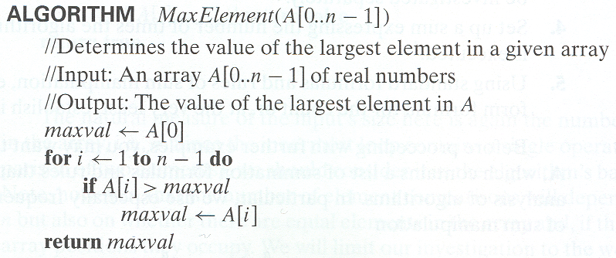
Example 1: Maximum element
_{n-1}
C(n) = ∑ 1 = n -1 ∈ Θ (n)
^{i=1}

Slide 43
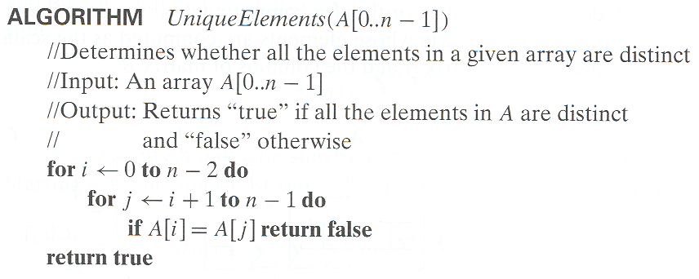
Example 2: Element uniqueness problem
_{n-2 n-1 n}
C_{worst} (n) = ∑ ∑ 1 = ∑ [(n-1)–(i+1)+1] ∈ Θ (n²)
^{i=0 j=i+1 i=0}

Slide 49
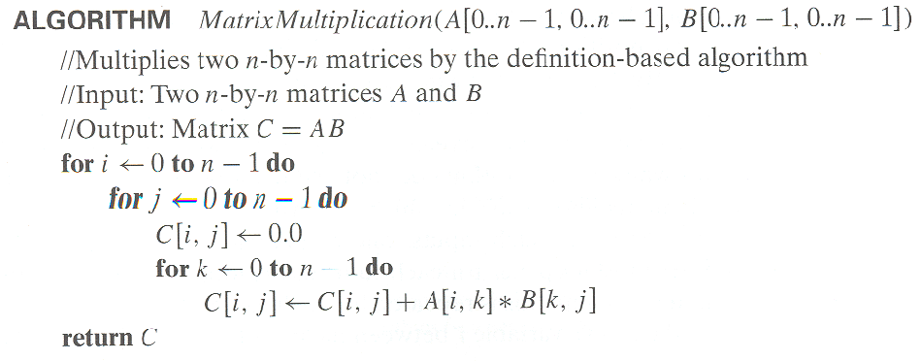
Example 3: Matrix multiplication
n-1 n-1 n-1 n-1 n-1 n-1
M(n) = ∑ ∑ ∑ 1 = ∑ ∑ n = ∑ n² = n³ ∈ Θ (n³)
i=0 j=0 k=0 i=0 j=0 i=0
M(n) = number of multiplications * size of matrix = n * n²

Slide 50
Example 4: Gaussian elimination
Algorithm GaussianElimination(A[0..n-1,0..n])
//Implements Gaussian elimination of an n-by-(n+1) matrix A
for i ← 0 to n - 2 do
for j ← i + 1 to n - 1 do
for k ← i to n do
A[j,k] ← A[j,k] - A[i,k] ∗ A[j,i] / A[i,i]
Find the efficiency class and a constant factor improvement.
_{n-2 n-1 n}
M(n) = ∑ ∑ ∑ 1 = ?
^{i=0 j=i+1 k=i}

Slide 51
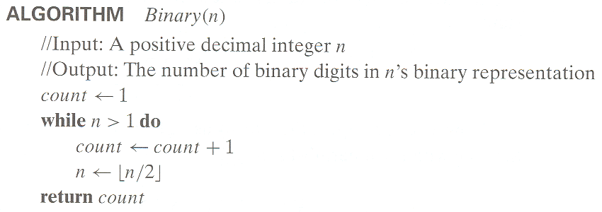
Example 5: Counting binary digits
It cannot be investigated the way the previous examples are.

Slide 52
Plan for Analysis of Recursive Algorithms
Decide on a parameter indicating an input’s size.
Identify the algorithm’s basic operation.
Check whether the number of times the basic op. is executed may vary on different inputs of the same size. (If it may, the worst, average, and best cases must be investigated separately.)
Set up a recurrence relation with an appropriate initial condition expressing the number of times the basic op. is executed.
Solve the recurrence (or, at the very least, establish its solution’s order of growth) by backward substitutions or another method.

Slide 53
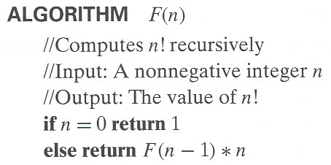
Example 1: Recursive evaluation of n!
Definition: n ! = 1 ⋅ 2 ⋅ … ⋅ (n-1) ⋅ n for n ≥ 1 and 0! = 1
Recursive definition of n!: F(n) = F(n-1) ⋅ n for n ≥ 1 and
F(0) = 1
Size:
Basic operation:
Recurrence relation:
Notes:
Note the difference between the two recurrences. Students often confuse these!
F(n) = F(n-1) n
F(0) = 1
for the values of n!
------------
M(n) =M(n-1) + 1
M(0) = 0
for the number of multiplications made by this algorithm

Slide 54
Solving the recurrence for M(n)
M(n) = M(n-1) + 1, M(0) = 0
Backward substitution:
M(n) = M(n-1) + 1, M(0) = 0
= [M(n-2) +1]+1 = M(n-2) +2
= [M(n-3) +1]+2 = M(n-3) +3
…
M(n) = n?

Slide 55

Example 2: The Tower of Hanoi Puzzle
Recurrence for number of moves:

Slide 65
Solving recurrence for number of moves
M(n) = M(n-1) + 1 + M(n-1),
- Move n-1 disks from peg 1 to 2
(but not n-1 moves)
- One move for n^{th} disk to peg 3
- Move n-1 disks from peg 2 to 3
M(n) = 2M(n-1) + 1, M(1) = 1
Use backward substitution?
M(n) = 2^{n} -1?

Slide 66
Tree of calls for the Tower of Hanoi Puzzle

Slide 67
move( ) method of Tower of Hanoi?
public void move(int n, Stack fromPeg, Stack toPeg,
Stack availablePeg){
if(n==1){
toPeg.push( fromPeg.pop() );
return;
}
move(n-1, fromPeg, availablePeg, toPeg);
move(1, fromPeg, toPeg, availablePeg);
move(n-1, availablePeg, toPeg, fromPeg);
}

Slide 68
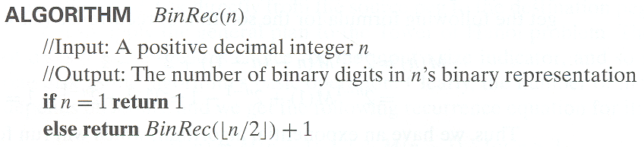
Example 3: Counting #bits
A(n) = A(⎣n/2⎦) + 1; A(1) = 0
A(2^{k} ) = A(2^{k-1} ) + 1 for k>0; A(2⁰ ) = 0
Use backward substitute
A(2^{k} ) = A(1) + k = k
if n =2^{k} , then k = log₂ n
A(n) = log₂ n

Slide 71
Fibonacci numbers
The Fibonacci numbers:
  0, 1, 1, 2, 3, 5, 8, 13, 21, …
The Fibonacci recurrence:
  F(n) = F(n-1) + F(n-2)
  F(0) = 0
  F(1) = 1
General 2nd order linear homogeneous recurrence with
constant coefficients:
  aX(n) + bX(n-1) + cX(n-2) = 0

Slide 72
Solving aX(n) + bX(n-1) + cX(n-2) = 0
Set up the characteristic equation (quadratic)
ar² + br + c = 0
Solve to obtain roots r₁ and r₂
General solution to the recurrence
  if r₁ and r₂ are two distinct real roots: X(n) = αr₁^{n} + βr₂^{n}
  if r₁ = r₂ = r are two equal real roots: X(n) = αr^{n} + βnr ^{n}
Particular solution can be found by using initial conditions

Slide 73
Application to the Fibonacci numbers
F(n) = F(n-1) + F(n-2) or F(n) - F(n-1) - F(n-2) = 0
Characteristic equation:
Roots of the characteristic equation:
General solution to the recurrence:
Particular solution for F(0) =0, F(1)=1:

Slide 74
Computing Fibonacci numbers
Definition-based recursive algorithm
Nonrecursive definition-based algorithm
Explicit formula algorithm
Logarithmic algorithm based on formula:
n
F(n-1) F(n)
0 1
=
F(n) F(n+1)
1 1
for n≥1, assuming an efficient way of computing matrix powers.

Slide 75
Fibonacci numbers algorithm
Algorithm F(n)
if n <= 1 return n
else return f(n-1) + f (n-2)
The numbers of additions need.
A(n) = A(n-1) + A(n-2) + 1; A(0) = 0, A(1) = 0
Similar to Tower of Hanoi, the efficiency of algorithm is exponential, a^{n}

Slide 76
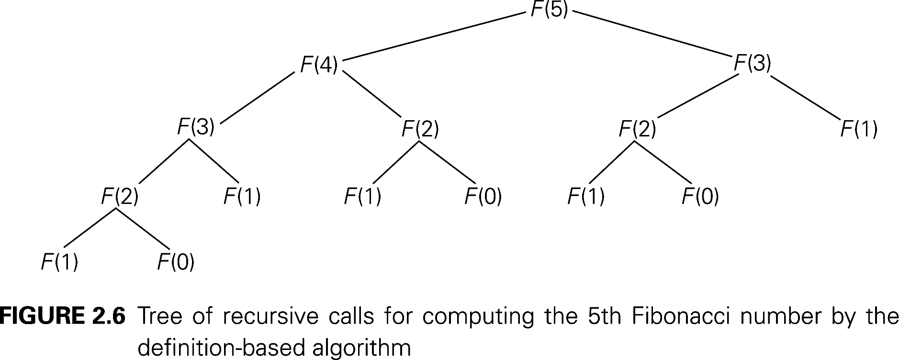
Number of Calls for Fibonacci numbers

Slide 77
Homework
Demonstrate the moves to solve the Tower of Hanoi problem for 5 dishes. The number of moves must be minimum.
Exercises 2.4 on page 102
  Questions: 1, 4, 5
Exercises 2.5 on page 109
  Question: 3

Slide 78
Homework
Climbing Stairs: Find the number of different ways to climb an n-stair staircase if each step is either one or two stairs. (For example, a 3-stair staircase can be climbed three ways: 1-1-1, 1-2, and 2-1.)

